Slide 1
Acquired heart disease in children part I
Solomon Gelaye
Pediatrician ,Assistant professor of pediatrics & child health

Slide 2
Rheumatic fever/
Rheumatic heart disease
Definition
:- inflammatory disease that can involve the heart, joints, skin, and brain.
:-Typically develops 2-4weeks after a streptococcal throat infection.

Slide 3
Epidemiology
0.3% - GAS tonsillitis treated with Penicillin.
3% - GAS tonsillitis untreated.
60% - known rheumatic patients with GAS tonsillitis (recurrence).

Slide 4
Acute rheumatic fever(ARF)
Epidemiology
Low-Risk population - rheumatic fever (ARF) incidence <2 per 100,000 school-age children per year, or all-age rheumatic heart disease (RHD) prevalence of <1 per 1,000 population.
Moderate/High-Risk population - ARF incidence >2 per 100,000 school-age children per year, or all-age RHD prevalence of >1 per 1,000 population.

Slide 5
Etiologic agent
Group A Beta Hemolytic (GABH) streptococci.
Gram positive cocci occurring in chains, capsulated with fimbria.
Rheumatogenic serotypes are:- 1,2,3,5,6,14,12,18,27,24,19,29

Slide 6
Etiology and pathogenesis
Acute Rheumatic Fever occurs 1-5 weeks after streptococcal throat infection.
The cytotoxicity theory suggests that a GAS toxin is involved
Immune-mediated pathogenesis
Binding of an M-protein N-terminal domain to a region of collagen type IV leads to an antibody response

Slide 7
Pathology
Primarily affects the heart, joints and central nervous system.
The major importance is its ability to cause fibrosis of heart valves, leading to crippling valvular heart disease, heart failure and death.

Slide 8
Investigations
Acute phase reactant – ESR, CRP
Evidence of recent Strep Gp A infection – ASO, throat culture, rapid antigen test, Anti DNAase Ab.
ECG – prolong PR interval.
Echocardiography – Valvulitis, Myo/pericarditis, Functional heart assessment.

Slide 9
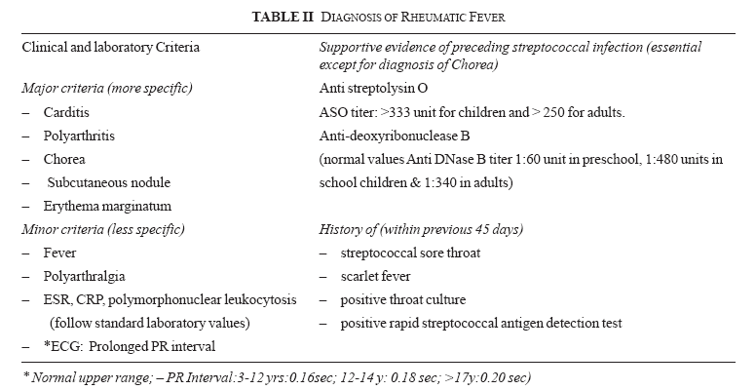
60-90%
70%
10-30%
0-5%
0-5%
0-5%

Slide 10
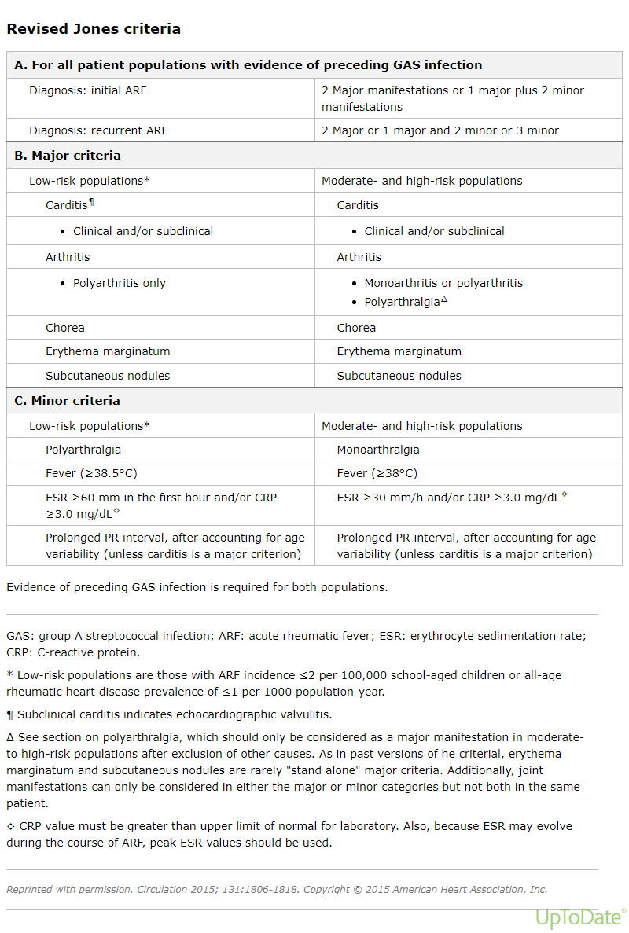

Slide 11
ARF – Carditis
Found in 60%-90% of cases, Mainly Valvulitis.
30-70% long term morbidity.
Mitral Valve most commonly affected.
Aortic Valve more specific for diagnosis ARF.
Acute heart damage is not influenced by treatment given.

Slide 12
ARF – Arthritis
2-5 weeks latent period post PSGA infection.
Large joint migratory polyarthritis.
Rapid response to anti-inflammatory treatment.
No long term morbidity.

Slide 13
ARF– Sydenham Chorea
10–15% of patients with acute RF
Inflammation involving the basal ganglia, cerebral cortex and cerebellum.
Diagnostic as single criteria.
Self limited disease

Slide 14
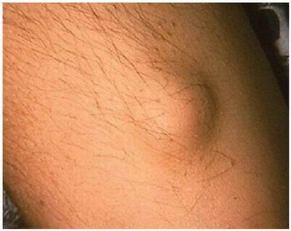
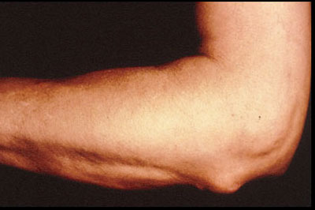
Subcutanous nodule related with significant rheumatic heart disease.

Slide 15
ARF-Erythema Marginatum
Appear in less than 5% of cases.
Erythematous, serpiginous[ regular border], macular lesions with pale centers .
Occurs primarily on the trunk and extremities, but not on the face.
Accentuated by warming the skin.
Associated with carditis

Slide 16
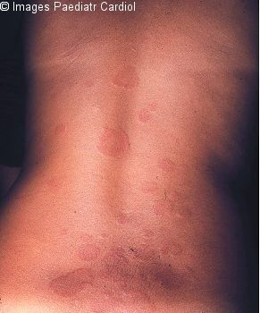
Erythema Marginatum

Slide 17
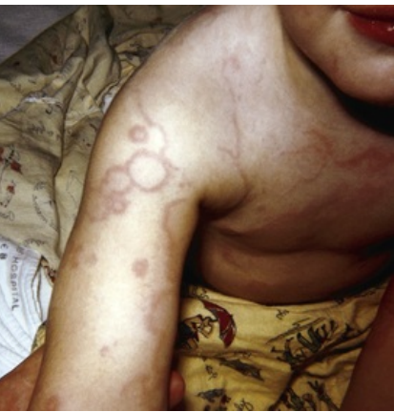

Slide 18
Jones criteria for the diagnosis of ARF
 | Low-risk population ARF incidence ≤2 per 100 000 school-aged children or all-age RHD prevalence of ≤1 per 1000 population year | Moderate/high-risk population Children not clearly from a low-risk population
Major criteria
Carditis | Clinical and/or subclinical* | Clinical and/or subclinical*
Arthritis | Polyarthritis | Monoarthritis, polyarthritis and/or polyarthralgia
 | Chorea | Chorea
 | Erythema marginatum | Erythema marginatum
 | Subcutaneous nodules | Subcutaneous nodules
Minor criteria
Carditis | Prolonged PR interval† | Prolonged PR interval†
Arthralgia | Polyarthralgia | Monoarthralgia
Fever | ≥38.5°C | ≥38°C
Markers of inflammation | Peak ESR ≥60 mm in 1 h and/or CRP ≥3.0 mg/dL | Peak ESR ≥30 mm in 1 h and/or CRP ≥3.0 mg/dL

Slide 19
Diagnosis
Initial attack : 2 major manifestations, or 1 major and 2 minor manifestations, plus evidence of recent GAS infection.
Recurrent attack : 2 major, or 1 major and 2 minor, or 3 minor manifestations (the latter only in the Moderate/High-Risk population), plus evidence of recent GAS infection

Slide 20
ARF – Primary Treatment
10 days penicillin to eradicate GAS.
High dose Aspirin (50-100 mg/kg/day) until clinical and laboratory evidence of inflammation resolve.
If severe carditis – Steroid (prednisone 2mg/kg/day for 2 weeks and taper down)

Slide 21
Complications
Long-term sequelae of RF are essentially limited to the heart
Approximately 50–70% of patients with carditis recover with no residual heart disease
The more severe the initial cardiac involvement, the greater the risk for residual heart disease.

Slide 22
ARF : Prophylaxis
  1º - prevents 1st episode of ARF.
  2º - prevents recurrences of ARF.
    Arthritis - at least 5 years
    Carditis - at least 10 years (recurrence free & no residual heart disease)

Slide 23
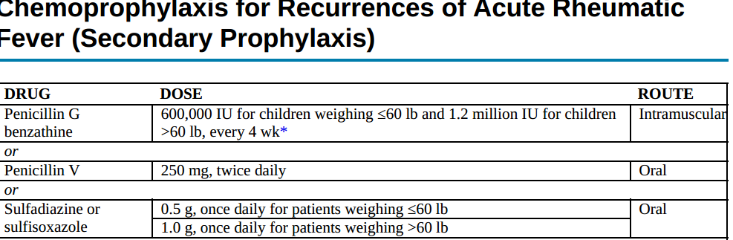

Slide 24
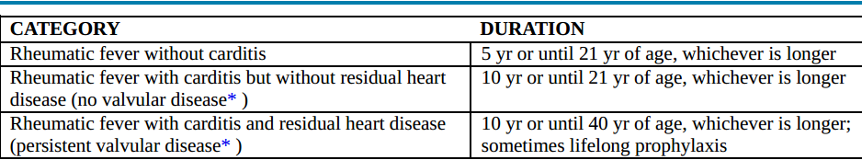
  Secondary prophylaxis

Slide 25
Rheumatic heart disease

Slide 26
Introduction
The valvular lesions begin as small verrucae composed of fibrin and blood cells along the borders of 1 or more of the heart valves.
The mitral valve is affected most often, followed in frequency by the aortic valve.

Slide 27
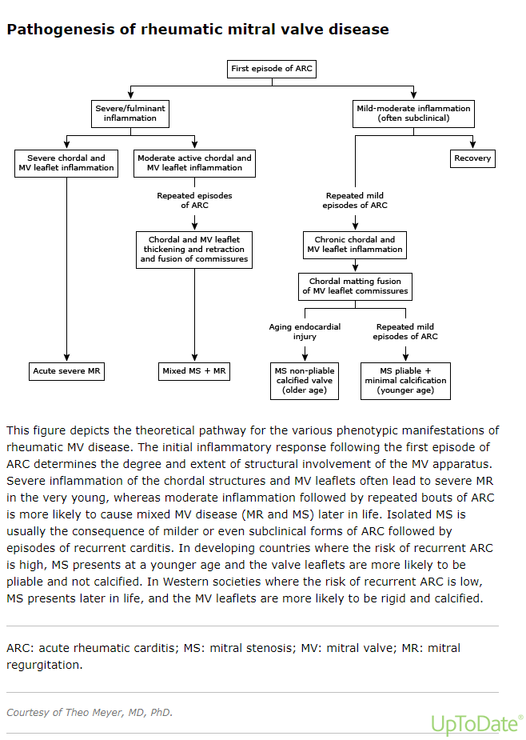

Slide 28
Mitral stenosis
Mitral valve is located in the left side of the heart between left atrium and left ventricle.
Narrowing of the mitral valve MVA <2.5 sqcm
Symptom start to occur only when the valve area become < 2.5cmsq.

Slide 29
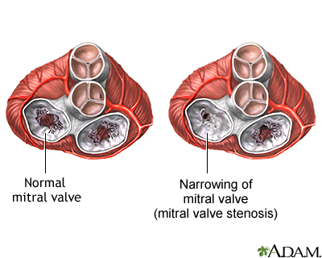
Mitral stenosis

Slide 30
Mitral stenosis
Grade MVA Pressure gradient PCWP
Mild >1.5 <5mmHg <10mmHg
Moderate 1-1.5cm 5-10mmHg 10-17mmhg
Severe <1cm >10mmHg >18mmHg

Slide 31
Mitral stenosis causes
Rheumatic, for all practical purpose .
Other theoretical considerations:
Congenital
SLE
Rheumatoid Arthritis
Amyloidosis
Malignant Carcinoid
Large vegetation, LA myxoma

Slide 32
Pathophysiology of Mitral stenosis
As MV starts narrowing LA pressure Î=> PCWP Î = PV pressure Î =>interstitial edema.
Patient may be normal at rest & becomes symptomatic as he/she starts exercising.
As interstitial edema Î PV becomes flooded with fluid.

Slide 33
Mitral stenosis
Compensatory mechanisms :
Lymphatic drainage Î
Pulmonary constriction Î
Over a period time –intimal and muscle hypertrophy and hyperplasia=> fixed pulmonary arterial hypertension.

Slide 34
Mitral stenosis
History
Physical examination
ECG
Chest X-ray
Echocardiography
Cardiac Catheterization

Slide 35
History
History of Rheumatic Fever, remembered in only fifty percent of cases.
Orthopnea
Breathlessness on effort-PND
Palpitation
Hemoptysis-usual in children
Angina(due to severe PHT)
Dysphagia(compression by esophagus by the enlarged LA

Slide 36
Physical examination
JVP raises as pulmonary arterial pressure starts rising
(initially prominent a wave followed by prominent V wave )=>Hepatomegaly => pedal edema
Hepato jugular reflex
Apex beat normal in its position as the LV is normal
Tapping apex beat
Parasternal heave(forcible contracting RV)
P2 palpable PA palpable on systolic palpation.

Slide 37
Physical examination
Loud S1
Opening snap –bell of streetscape- b/n apex & sternal border.
Mid diastolic murmur -=> as severity increases presystolic accentuation can also occur
As severity increases you can still here loud P2, Grhamsteel murmur
Pulmonary ejection murmur heard in advanced PHT

Slide 38
The most important to tell the severity of the murmur is not the loudness of the MS murmur but it is the length of the MS murmur, Evidence of CHF and evidence of PHT.

Slide 39
Mitral regurgitation
Chronic mitral regurgitation-
Gradual onset with gradual development.
Allows adaptation of the heart
May not have other features other than palpitation for years.
LA starts dilating and show increased in compliance
LV also starts dilating & compensate for forward SV
Even compensation occur when the patient is doing vigorous exercise.

Slide 40
Chronic MR doesn’t immediately decrease functional state of the patient.
It is a chronic processes.

Slide 41
Causes of chronic MR
Rheumatic
MVP(Marfan )
DCM, RCM, HCM
Cleft MV
SLE & RhA
Prosthetic valve dysfunction
Infective endocarditis

Slide 42
Diagnosis of MR
History
Physical examination
ECG
Chest X-ray
Echocardiography
Cardiac Catheterization

Slide 43
History
Palpitation(commonest)
Breathlessness on effort
Orthopnea=>Paroxysmal nocturnal dyspnea (PND)
Pedal edema
Acute breathlessness-pulmonary edema=>dramatic deterioration of patient

Slide 44
Physical finding
Apex beat shift down and out(LV dilation)-=>Focefull ill sustained (regurgitant lesion)
Parasternal heave(PAHT)
Palpable PA,
Palpable P2
Raised JVP-> Hepatomegay =>Pedal edema
Basal creps

Slide 45
Physical finding
S1 soft
S3 gallop
Pan-systolic murmur best heard at the apex radiating to Lt. axilla.
All features of PAHT:-
Loud P2-Grhamsteel
Mid systolic murmur
Pulmonary ejection murmur

Slide 46
Management principle
Treat acute complications :
Arthritis, CHF, Sydenham chorea, Infective endocarditis, Atrial fibrillation, pulmonary hypertension, Cardiogenic shock etc.
2. Surgery-valve repair or replacement.
3. Anticoagulation
4. Secondary prophylaxis[prevention of recurrent

Slide 47
Infective Endocarditis

Slide 48
Infective endocarditis
Definition: infection of the endocardium and/or heart valves, chordae tendinae or sites of shunting septal defects.
IE is not a uniform and varies with
Clinical manifestation
Underlying cardiac illness
Micro-organism involved

Slide 49
Microbiology
Most cases are caused by relatively small number of micro-organisms.
Gram positive cocci account for 90% of cases (adult studies).
Streptococcus viridans – are the most common causes at all ages.
Staphylococcus aureus & CONS – 2nd most common organisms.

Slide 50
About 75-90% of cases after the neonatal period are associated with an underlying cardiac diseases
Neonatal and infantile IE is rare & in most cases occur in structurally normal hearts .
Poor dental hygiene results in a greater risk for endocarditis after brushing teeth & chewing hard food.

Slide 51
Pathogenesis
Modes of endothelial injury
High velocity jet
Flow from high pressure to low pressure chamber
Flow across narrow orifice of high velocity
Bacteria deposited on edges of low pressure sink or site of jet impaction

Slide 52
Pressure gradient required producing a high-velocity jet stream
The high flow results in a Venture effect (a low pressure area adjacent to the area of high flow)
Bacteria to settle in this area of low pressure.

Slide 53
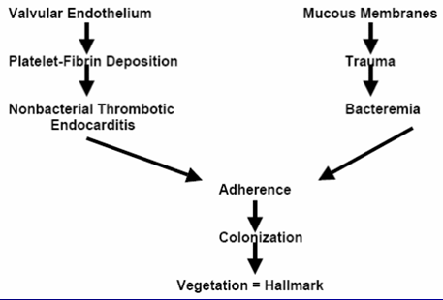

Slide 54
Clinical Feature
Fever is present in almost all cases.
Anemia
Cardiac Manifestations: sign& symptoms of underlying cardiac lesion and CHF (33%)
New or changing heart murmurs are common.
Conduction block, valvular incompetence .
Embolic Manifestation
Immune complex deposit
Splenomegaly(70)%

Slide 55
Laboratory Diagnosis
Blood culture at least three bottle from separate venipuncture continuous
CBC,ESR,Urine analysis

Slide 56
Diagnostic Criteria
Duke criteria
There are three categories

Slide 57
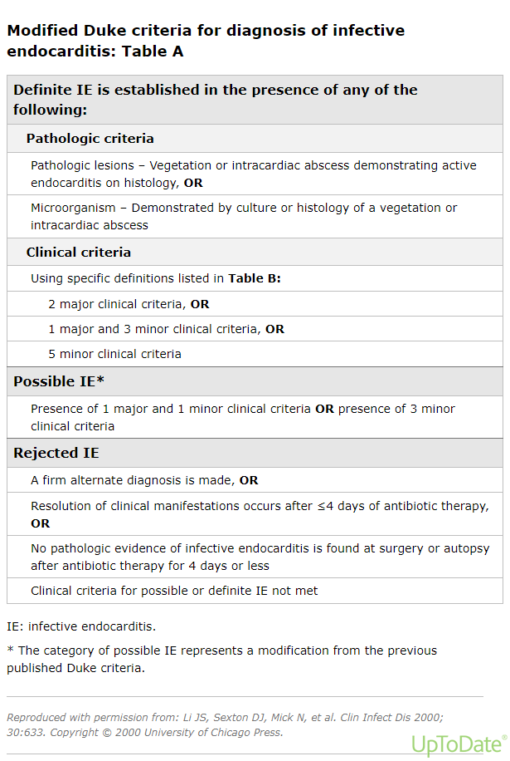

Slide 58
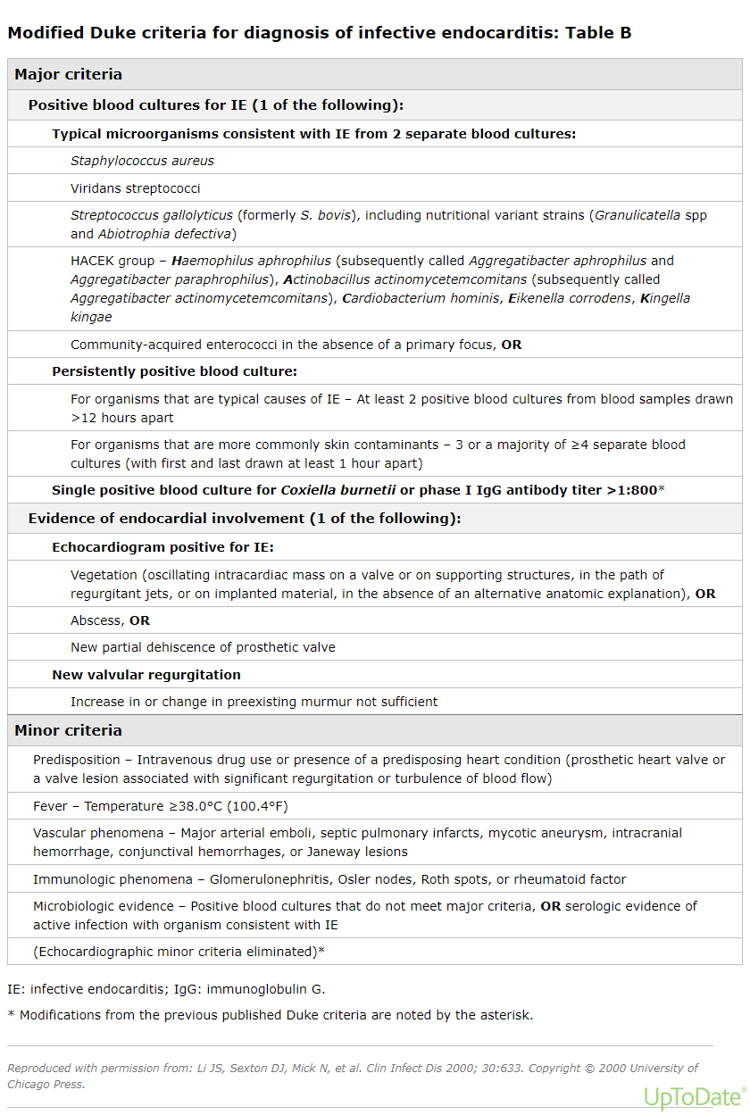

Slide 59
Cont..
Clinical criteria: 1) definite
2 major criteria; or
1 major criterion and 3 minor criteria; or
5 minor criteria
Possible IE:
1 major criterion and 1 minor criterion; or
3 minor criteria

Slide 60
Cont..
Rejected IE:
Firm alternative diagnosis explaining evidence of IE; or
Resolution of IE syndrome with antibiotic therapy within 4 days; or
No pathologic evidence of IE at surgery or autopsy, with antibiotic with for 4 days
Does not meet criteria for possible IE as above

Slide 61
management
Principles
Eradication of causative organism
Rx of heart failure
Surgical management.
Management of complication
Prevention

Slide 62
Cont…
Eradication of causative organism
Antibiotic shall be
1) high dose with high serum conc.
2) bactericidal
3) in combination with synergistic abc.
4) prolonged period Rx
5) often parenteral

Slide 63
WHY?
1) vegetation & biofilm is avascular,so abc reach only by diffusion
2)high colony of bact. in vege
3)low multiplication rate of bacteria in vegetation
The initial antibiotic should target
NVE and late PVE
In general Ampicillin-sulbactam and Gentmicin are choice of antibiotics.
Patients with prior histories of penicillin allergy can usually be treated with ceftriaxone

Slide 64
Duration of therapy
Depends on identified organism and nature of valve.
1)NVE caused by S.viridans 2-4wks.
2) NVE caused by others 4-6wks
3)All PVE treated for at least 6wks.

Slide 65
Indication for surgery.
Anterior mitral leaflet vegetation, with size >10 mm.
One or more embolic event during 1st 2wk antibiotic
Valvular dysfunction.
HF unresponsive to medical therapy.
New heart block , Perivalvular extension
Failure to sterilize the blood despite adequate antibiotic levels.

Slide 66
Complication of IE and prognosis
Cardiac: Myocardial abscesses and toxic myocarditis
Life-threatening arrhythmias & aneurism.
Systemic emboli : CNS & renal manifestations.
Pulmonary emboli may occur in children with VSD or TOF,
Prognosis: despite the use of antibiotic , mortality is at 20-25%.
Poor prognostic factor : PVE, presence of complication, S.aureus fungal infection,some Echo finding.

Slide 67
Prevention of IE
Antimicrobial prophylaxis before various procedures
Proper general dental care and oral hygiene are most important in decreasing the risk of IE
Vigorous treatment of sepsis and local infections decrease risk of IE
Parenteral antibiotics recommended in high-risk patients

Slide 68
Acquired heart disease in children II

Slide 69
Acute Myocardits
Definition-: an inflammatory infiltration of the myocardium with associated necrosis, degeneration or both.
WHO (marburg Criteria.1996)- A minimum of 14 infiltrating leucocytes per mm, preferably T lymphocytes and up to 4 macrophages may be included.

Slide 70
Contd…
The incidence and prevalence not known because of large numbers of asymptomatic cases.
The severe forms are observed predominantly in the age below 3 years.
The mild forms are seen predominantly in preschool and school age children.

Slide 71
Etiology
Infections:
Viruses -adeno virus, coxsackievirus, echovirus, and many other viruses including Human immunodeficiency viruses.
Rarely- bacteria, rickettsia, fungi, protozoa, and parasites.
HIV-1 virion.

Slide 72
Etiology
Non infectious
A cell mediated immunologic reaction.
Cardio toxic drugs-cyclophosphamide, anthracyclins
Connective tissue disorders(SLE, RA)
Acute rheumatic fever

Slide 73
Etiology cont..
Immune-mediated disease-: Acute fever, Kawasaki disease
Collagen vascular diseases:- SLE, ARF
Toxic myocarditis: drug ingestion, diphtheria exotoxin & anoxic agents.

Slide 74
Clinical manifestation
History of upper respiratory tract infection may precede presentation in older children.
Fever, shortness of breath; headache,
Pale skin, weakness, decline of appetite

Slide 75
Clinical manifestations
Chest pain due to coexisting pericarditis.
Enlarged heart, Tachycardia, Cardiac dysfunction.
Soft systolic murmur on the apex,
Decreased arterial pressure.

Slide 76
Physical Examination
(Myocarditis)
  Wheezing on lung auscultation,
  enlargement of liver,
  Edema of the extremities,

Slide 77
Laboratory workup
CBC
î acute phase reactant
Serum viral antibody titer
ANA, anti-Ro/SSA
Serum cardiac enzymes:-CPK, Troponin I, T
ECG
Echocardiogram
Gallium scanning
Gadollinium-enhanced
MRI
Antimyosin scintigraphy

Slide 78
Laboratory investigations
Creatine phosphokinase(CPK) elevated in 7.5% cases,
Troponin I/T elevete in 50% cases.
Brain natriuretic peptide(BNP )

Slide 79
Electrocardiography
Decrease of waves voltage
Conduction impairments
Arrhythmias-Atrial Fibrillation

Slide 80
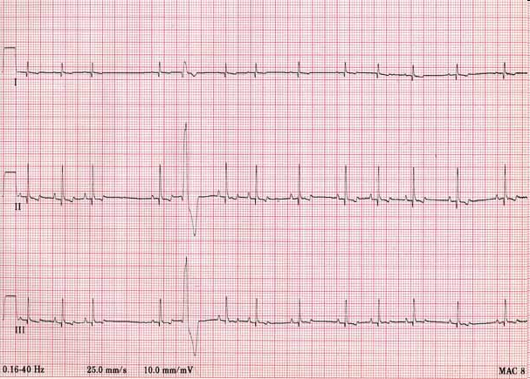

ECG :tachycardia, reduced QRS complex voltage,
ST-segment and T-wave abnormalities
Premature ventricular beats
Paroxismal tachycardia

Slide 81
Echocardiography
Myocardium is diffusely thick,
Dilatation of chambers,
Reduced myocardial contractility,
Possible pericardial effusion.

Slide 82
Management of Acute myocarditis
Heart failure management
Arrhythmia management
Exercise restriction
Follow up-because persistent chronic inflammation
May lead to dilated cardiomyopathy

Slide 83
Cardiomyopathies

Slide 84
Cardiomyopathies
There are several types of cardiomyopathies defined by the WHO:
“Dilated cardiomyopathy” or DCM,
“Hypertrophic cardiomyopathy” or HCM,
“Restrictive cardiomyopathy” or RCM,
Other-Arrythmogenic Right Ventricular Dysplasia(ARVD)

Slide 85
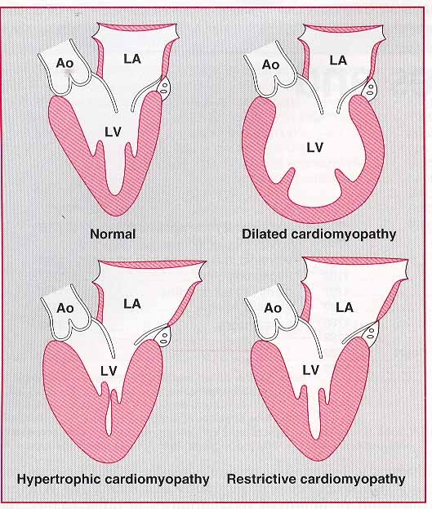
Cardiomyopathies

Slide 86
Incidence & Prognosis cardio..
3-10 cases per 100,000 population.
1% of all pediatric cardiac diseases.
During infancy incidence is 10 times higher in than older children.

Slide 87
Incidence & Prognosis cardio..
Death from progressive pump failure
1-year 25%
2-year 35-40%
5-year 40-80%
Stabilization observed in 20-50% of patient.
Complete recovery is rare.

Slide 88
Classification
Primary
genetic abnormalities of cardiac muscle)
  Dilated
  Hypertrophic
  Restrictive
Secondary
infections, metabolic and nutritional diseases, endocrine disorders, neuromuscular diseases, blood diseases, tumors)

Slide 89
Dilated Cardiomyopathy
A progressive disease of heart muscle that is characterized by LV dilatation & systolic dysfunction.

Slide 90
Dilated Cardiomyopathy
      Pathology:- Increased heart size & weight.
Normal wall thickness.
Heart dysfunction out of portion to fibrosis.

Slide 91
Dilated Cardiomyopathy
Etiology:-
Genetic basis or
Sequelae of viral myocarditis.
In 20-50 % familial(Autosomal dominant inheritance is most commonly encountered)
Mutations in several cardiac structural or metabolic genes have been identified.

Slide 92
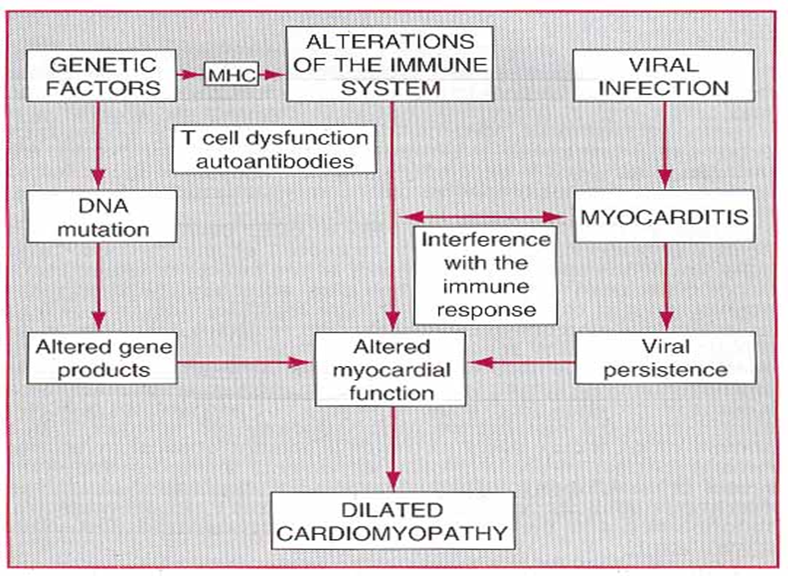
Dilated CMP-Pathophysiology

Slide 93
Dilated Cardiomyopathy
LV Failure=> increase in LVEDV =>,
PV and PCWP.
MV regurgitation result from papillary muscle dysfunction or severe dilatation of mitral valve annulus.

Slide 94
Clinical Manifestations
Symptoms of heart failure occur insidiously, but some time suddenly;
Irritability, anorexia, abdominal pain,
Cough, dyspnea with exertion from pulmonary congestion.
Respiratory symptoms and failure to thrive in Infants and younger children.

Slide 95
Clinical M/S cont..
Cool and pale skin ;
Decreased arterial pulse , tachycardia, palpitation.
Increased Jugular venous pressure , hepatomegaly, edema;
Holosystolic murmurs of mitral and tricuspid insufficiency;
Blood pressure may be low,& pulse pressure may be narrow;
S3 gallop rhythm is audible.
Cardiomegaly

Slide 96
Diagnosis
Clinical signs
Chest x-ray
CT Scan
Echocardiogram
12-lead ECG
Heart biopsy
MRI (magnetic resonance imaging)
Cardiac catheterization

Slide 97
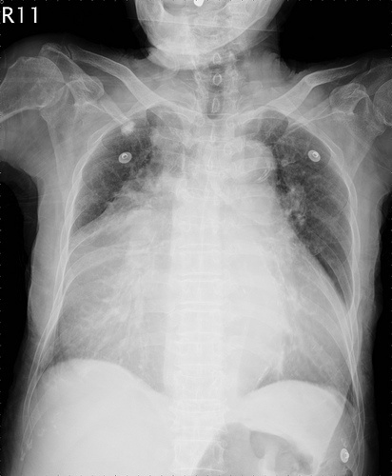

Slide 98
ECG
Atrial enlargement, varying degrees of left or right ventricular hypertrophy;
Doppler studies
Echocardiography
Decreased flow velocity through the aortic valve.
Mitral regurgitation.
In long-standing cases, evidence of Pulmonary hypertension may exist.

Slide 99
Serious complications
Ventricular arrhythmias => syncope and sudden death,
Pulmonary or systemic emboli from intra-cardiac thrombi.
Development of PVD from chronically left atrial pressure.

Slide 100
Prognosis
Progressively down hill, although some patients may remain stable for years.
Treatment of HF may result in temporary remission,
Relapses are common and in time – patients become resistant to therapy.
Prognosis for survival beyond a year is poor.

Slide 101
Management
Limit activity.
Salt restriction.
Fluid restriction for significant low Na+.
Initiate medical therapy.
  ACE inhibitors,
  Loop diuretics.
  Digoxin,
  Beta –blockers (metoprolol, carvedilol).
  Hydralazine/nitrate combination.

Slide 102
Anticoagulation (If there is hx of thromboembolism, presence of mural thrombi).
Intravenous dopamine / dobutamine in case of cardiogenic shock.
Cardiac transplantation.

Slide 103
Acute Pericarditis
Causes may be idiopathic or
Secondary causes includes
-Viruses (cocksakie,flu,EBV, mumps)
-Bacteria (pneumonia, ARF, TB,Staph, Streps,
-Fungi
Drugs: Penicillin, INH, Hydralazine, Cancer drugs
Others: uremia, RA, SLE, myxedema, malignancy, sarcoidosis

Slide 104
Acute Pericarditis
usually a benign course
virulent bacteria (H. flu, E. coli) can cause constrictive pericarditis and subsequent tamponade
uncomplicated pericarditis usually responds to rest and anti-inflammatories

Slide 106
Clinical Features-pericarditis
Chest pain
-central
-worse on inspiration and lying flat
-Relief with sitting forward
-Pericardial friction rub
-Signs of pericardial effusion, cardiactamponade
- Fever may be there

Slide 107
Investigating-peicarditis
ECG
-Saddle shaped ST segment elevation but may be normal also
Blood test
-CBC,ESR
-Cardiac enzymes(troponine may be elevated)
-Blood culture,autoantibodies,viral serology, thyroid function test
CXR (Cardiomegally,pericardial effussion)
ECHO (pericardial effussion)

Slide 108
Treatment
Bed rest and oral non steroidal anti-inflammatory
drugs (NSAIDs).
If NSAIDs are unsuccessful, steroids may be considered once bacterial causes have been excluded.
Colchicine has not been well studied in the pediatric population
Bacterial pericarditis should be treated for at least 3 to 4 weeks with intravenous antibiotics.

Slide 109
Complete resolution usually in <6 weeks.
Relapse occurs in a small subset of patients, typically improving with reinstitution of NSAIDs or steroids.
Constrictive pericarditis rarely occurs as a late complication of viral pericarditis.

Slide 110
Prognosis
Survival for patients with bacterial pericarditis currently is >90%
Risk factors for poor outcome include young age at diagnosis, septicemia, tamponade, delay in diagnosis, inadequate drainage, concurrent myocarditis, and a staphylococcal etiology
Constrictive pericarditis can be a late complication , most commonly associated with Staph.aureus, H.influenzae, or S.pneumoniae infections.

Slide 111
Tuberculous Pericarditis
The typical onset is insidious with symptoms of low-grade fever, night sweats, weight loss, malaise, dyspnea, and chest pain.
The presentation may be complicated by subacute pericardial tamponade.
Direct extension of miliary tuberculosis or lymphatic spread into the pericardium.
Hematogenous spread may occur without evidence of pulmonary infiltrates.
Most patients have a positive Mantoux skin test.

Slide 112
The pericardial fluid, when aspirated, is sero sanguineous or hemorrhagic with lymphocyte predominance.
Pericardial biopsy is useful to provide histologic confirmation.
Pericardial fluid adenosine deaminase levels are diagnostic for tuberculous pericarditis if >50 U/L.
Mycobacterium cultures may take up to 6 weeks to grow; thus, treatment should be initiated before confirmation of diagnosis.

Slide 113
Steroid therapy may be useful to reduce inflammation and increase pericardial fluid resorption .
Early in the course of the disease, pericardiectomy is difficult due to the presence of diffuse inflammatory and caseous material.
Constrictive pericarditis may develop after recovery.
Worldwide, tuberculous pericarditis is one of the leading causes of constrictive pericarditis .

Slide 114
HIV and Other Infections
Pericardial effusions are common in patients with human immunodeficiency virus (HIV) and are present in up to 25% of children with HIV infection .
Children with HIV rarely develop tamponade. Pericardial fluid cultures typically are negative.

Slide 115
Thank You

